Slide 1
OpenShift Pipelines

Slide 2
Our CI/CD Strategy
What is OpenShift Pipelines?
Tekton Deep Dive
Demo
What we’ll be discussing today

Slide 3
Red Hat
CI/CD Strategy

Slide 4



Cloud-Native CI/CD
Containers
Serverless
DevOps
Built for container apps and runs on Kubernetes
Runs serverless with no CI/CD engine to manage and maintain
Designed with microservices and distributed teams in mind
Notes:
We are here to talk about the next generation of continuous integration and continuous deployment technology. What does really Cloud Native really mean in this context. Application in cloud native are *mostly open source technologies. There architectures are microservices in containers or serverless instead of the monoliths or applications on virtual machines. Those containers are dynamically orchestrated, we optimize resources utilization and scale as needed. The key to all of these are containers, it have changed the way we deliver software. We can package all the binaries, dependencies and distribute that. What do you do when you have a lot of containers, thats where kubernetes comes in. Kubernetes is a platform for dynamically orchestrating containers. You can tell it what needs to be run in the container, what services it needs and the storage it needs, Kubernetes will take care of the rest.

Slide 5
Continuous Integration (CI) and Continuous Delivery (CD)
GIT COMMIT
RELEASE
Code
Run
Debug
Build
Test
Package
Deploy
Stage
Prod
DEVELOPMENT
CONTINUOUS INTEGRATION
CONTINUOUS DELIVERY

Slide 6

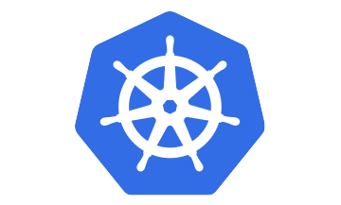


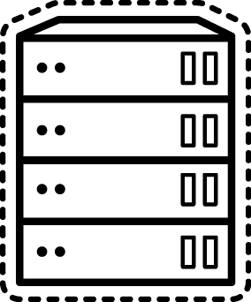
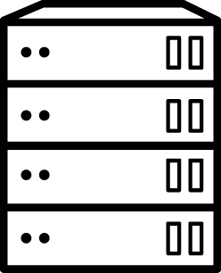
One Continuous Delivery
Multiple Clouds
Multiple Platforms
Multiple Geographies
Isolated Environments
Pre-Production
Production
LOCAL DEV
CI
CD
CD
VMware
OpenStack
baremetal
Workstation
Cloud
AWS
GCP
Azure

Slide 7
One Continuous Delivery
Multiple Clouds
Multiple Platforms
DEVELOPMENT
CONTINUOUS INTEGRATION
CONTINUOUS DELIVERY
Workstation
Kubernetes
Kubernetes
Azure
AWS
GCP
VMware
OpenStack
baremetal
Kubernetes

Slide 8
Traditional, Cloud-Native and the Transition
Traditional CI/CD
Cloud-Native CI/CD
Monolithic
Central governance
Existing investments
Serverless
Cross-functional teams
Kubernetes-native

Slide 9


Traditional, Cloud-Native and the Transition
Traditional CI/CD
Cloud-Native CI/CD
Monolithic
Central governance
Existing investments
Serverless
Cross-functional teams
Kubernetes-native
Red Hat
OpenShift
Offering

Slide 10
What is OpenShift
Pipelines?

Slide 11


An open-source project for providing a set of shared and standard components for building Kubernetes-style CI/CD systems
Governed by the Continuous Delivery Foundation
Contributions from Google, Red Hat, Cloudbees, IBM, Pivotal and many more

Slide 12





OpenShift Pipelines a Cloud-Native CI/CD Experience on OpenShift
Standard Kubernetes-style pipelines
Build images with Kubernetes tools
Declarative pipelines with standard Kubernetes custom resources (CRDs) based on Tekton*
Use tools of your choice (source-to-image, buildah, kaniko, jib, etc) for building container images
Run pipelines in containers
Deploy to multiple platforms
Scale pipeline executions on-demand with containers on Kubernetes
Deploy applications to multiple platforms like serverless, virtual machines and Kubernetes
Powerful command-line tool
Integration with OpenShift and Tooling
Run and manage pipelines with an interactive command-line tool
A CI/CD experience integrated with OpenShift, developer tools and IDE extensions

Slide 13
OpenShift Pipelines Architecture
Developer Tools
Dev Console
Tekton CLI
CodeReady Workspaces
(Eclipse Che)
Visual Studio Code
API
OpenShift Pipelines
CI/CD
Core
Operator
Extensions
Integrations
Tasks
Tekton Core
Kubernetes
OpenShift

Slide 14
Tekton Deep-Dive

Slide 15

OpenShift Pipelines Architecture
Define pipeline
Run pipelines
pipeline-pod-a
Pipeline
PipelineRun
pipeline-pod-b
Task
Task
TaskRun
TaskRun
pipeline-pod-c
Pipeline Controllers
(Tekton, ext, ...)
PipelineResource

Slide 16
Sample Voting App
Python
Golang
Frontend
Backend

Slide 17
CI/CD Pipeline
Pipeline
Container image (PipelineResource)
Build UI
(task)
Build Go
(task)
Deploy UI
(task)
Deploy Go
(task)
Container image (PipelineResource)
(source code) PipelineResource
(source code) PipelineResource

Slide 18
Task
Pipeline Resource
Pipeline
TaskRun
Pipeline Run
Tekton Pipeline Custom Resources

Slide 19
# display task list
$ tkn task list
# start task and select resources interactively
$ tkn task start* s2i-java-8
# start task with resources as arguments
$ tkn task start* s2i-java-8 \
--resource app-git=petclinic-git \
--resource app-image=petclinic-image
# display pipelines list
$ tkn pipeline list
# start pipeline and select resources interactively
$ tkn pipeline start petclinic-pipeline
# start pipeline with resources as arguments
$ tkn pipeline start petclinic-pipeline \
--resource app-git=petclinic-git \
--resource app-image=petclinic-image
# check pipeline run logs
$ tkn pipeline logs -f
# display pipeline runs
$ tkn pipelinerun list
Tekton CLI
Interactive command-line for performing actions on task, pipeline and pipeline resources
* coming soon

Slide 20
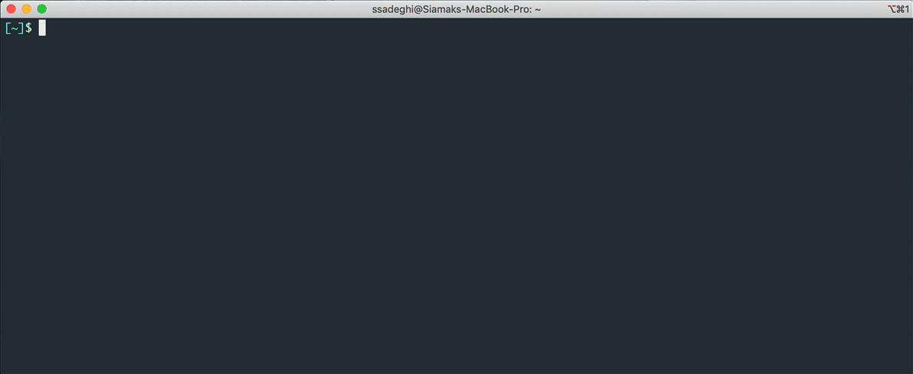

Slide 21
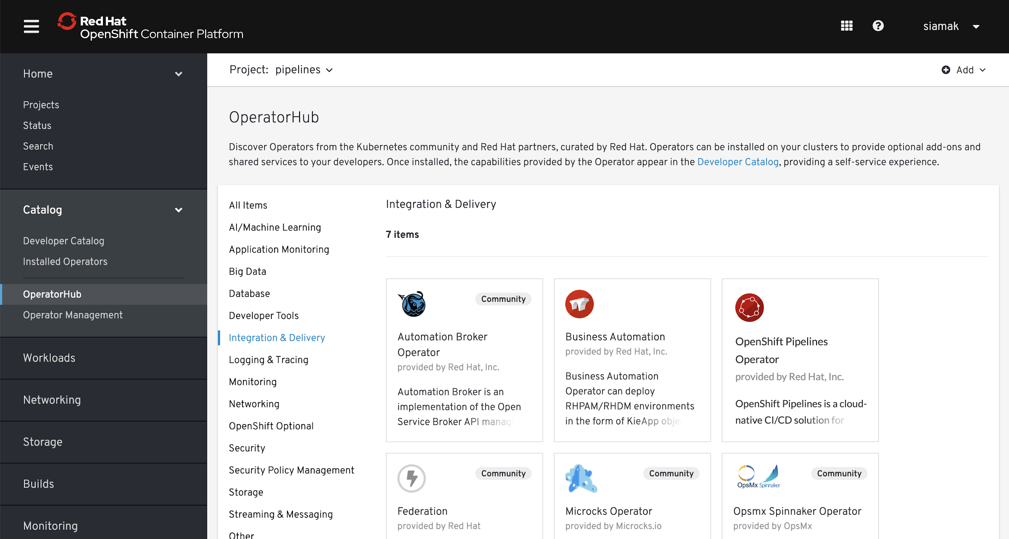
Installing Pipelines from Operator Hub

Slide 22
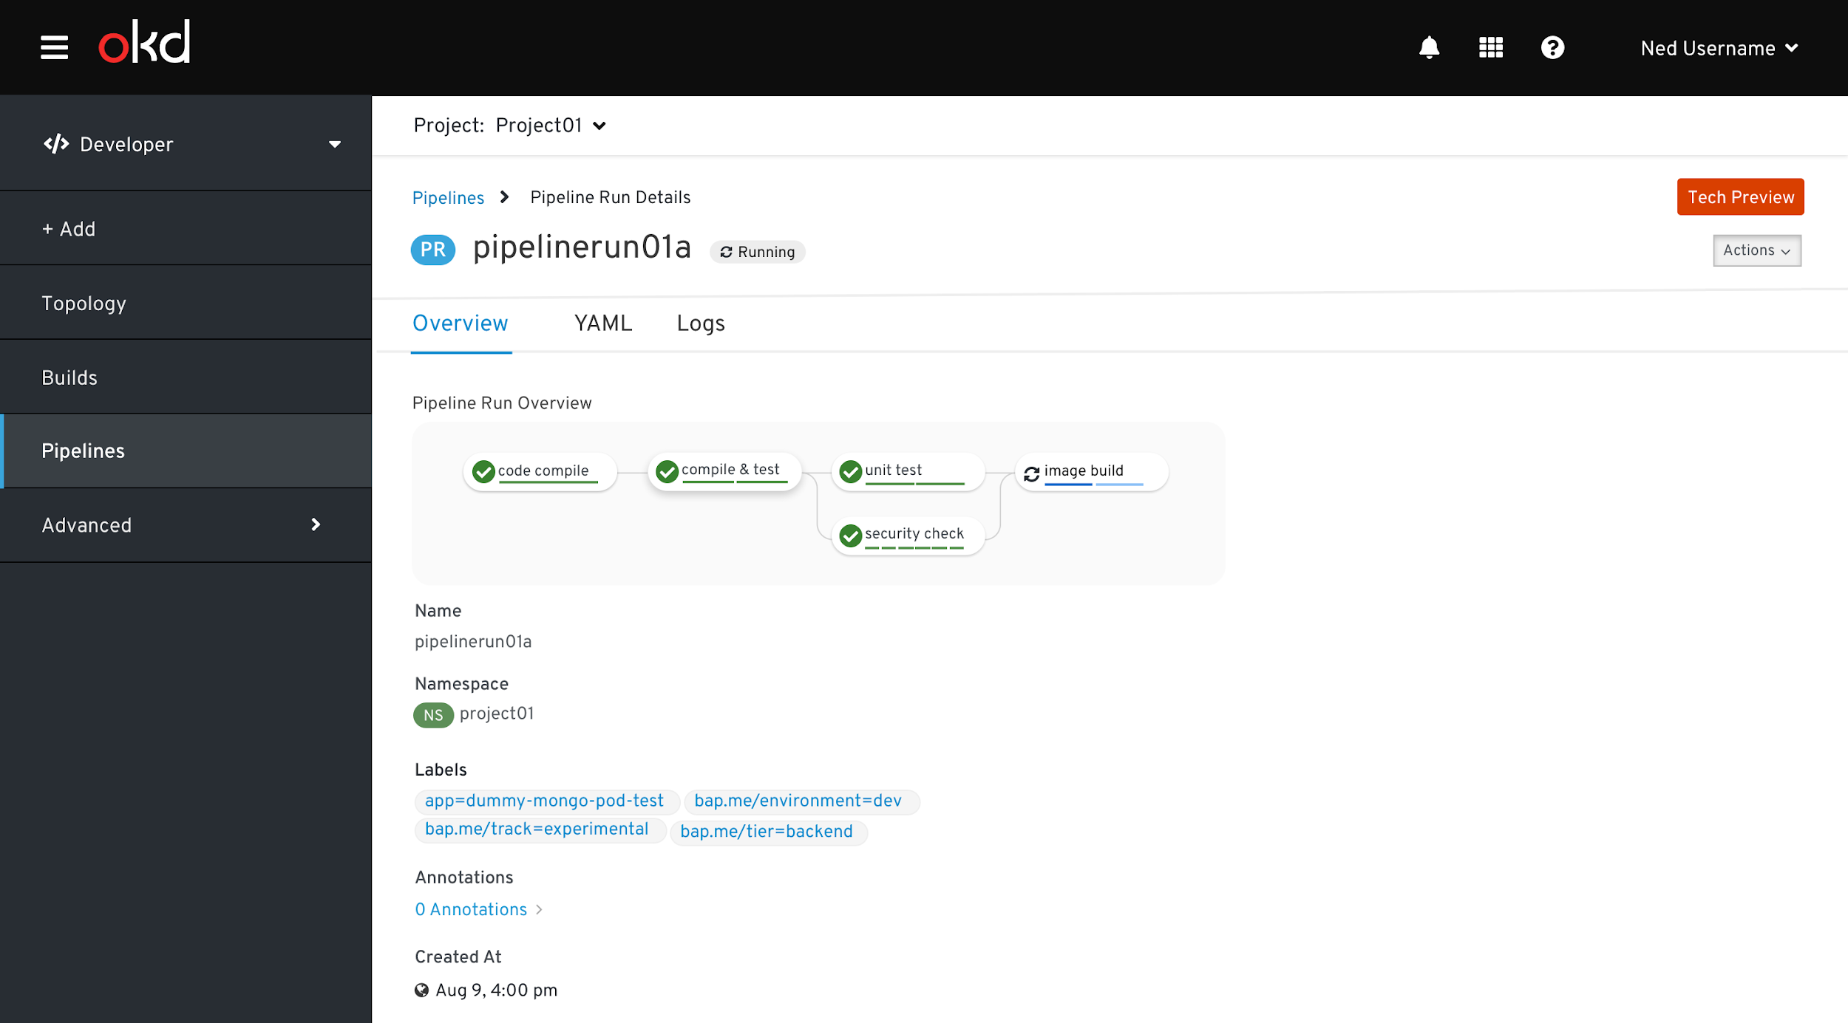
OpenShift Console - Developer Perspective

Slide 23
What’s next?

Slide 24
Resources
OpenShift Pipelines Documentation
OpenShift 1.0 Release Notes
OpenShift Pipeline Tutorial
Try Out Pipelines in Browser
OpenShift Pipelines Catalog
Tekton Project Documentation
Download Tekton CLI

Slide 25
Thank you
OPTIONAL SECTION MARKER OR TITLE
Red Hat is the world’s leading provider of enterprise open source software solutions. Award-winning support, training, and consulting services make Red Hat a trusted adviser to the Fortune 500.

Slide 26
Task
Pipeline
Container image (PipelineResource)
Build UI
(task)
Build Go
(task)
Deploy UI
(task)
Deploy Go
(task)
Container image (PipelineResource)
(source code) PipelineResource
(source code) PipelineResource

Slide 27
Task
Task
Defines a unit of work to be executed
A list of steps run sequentially
Step containers run in the task pod
Has inputs, outputs and parameters
Can run independent of pipelines
Step
Step
Step
Step

Slide 28
apiVersion: tekton.dev/v1alpha1
kind: Task
metadata:
name: mvn-build
spec:
inputs:
resources:
- name: source
type: git
outputs:
resources:
- name: source
type: git
steps:
- name: build
image: maven:3.6.0-jdk-8-slim
command:
- /usr/bin/mvn
args:
- package
- name: test
image: maven:3.6.0-jdk-8-slim
command:
- /usr/bin/mvn
args:
- verify
1
Task Example
2
1
Inputs to the task
3
2
Outputs from the task
3
Steps to be executed sequentially

Slide 29
Steps (in a task)
Series of Commands
Sequentially executed by the task
Each step in a task runs as a container
Task
Step
Step
Step
Step

Slide 30
PipelineResource
Pipeline
Container image (PipelineResource)
Build UI
(task)
Build Go
(task)
Deploy UI
(task)
Deploy Go
(task)
Container image (PipelineResource)
(source code) PipelineResource
(source code) PipelineResource

Slide 31
PipelineResource
Inputs and outputs of tasks and pipelines
git repository
image in a registry
imagestream*
...and more
Decoupled from pipeline definition
Reusable across pipelines
Pipeline
PipelineResource
(Git)
PipelineResource
(Image)
* coming soon

Slide 32
---
apiVersion: tekton.dev/v1alpha1
kind: PipelineResource
metadata:
name: ui-repo
spec:
type: git
params:
- name: url
value: https://github.com/openshift-pipelines/vote-ui.git
---
apiVersion: tekton.dev/v1alpha1
kind: PipelineResource
metadata:
name: ui-image
spec:
type: image
params:
- name: url
value: image-registry.openshift-image-registry.svc:5000/pipelines-tutorial/ui
PipelinesResource Examples
1
2
1
Git resource type
2
Git url
3
Container image resource type
4
Image url to OpenShift registry
3
4

Slide 33
Pipeline
Pipeline
Container image (PipelineResource)
Build UI
(task)
Build Go
(task)
Deploy UI
(task)
Deploy Go
(task)
Container image (PipelineResource)
(source code) PipelineResource
(source code) PipelineResource

Slide 34
Pipeline
Combine multiple tasks
Expresses task order (graph)
Has inputs and parameters
Links task inputs and outputs
Pipeline tasks run on different nodes
Pipeline
Task
Task
Task
Task

Slide 35
kind: Pipeline
metadata:
name: build-and-deploy
spec:
resources:
- name: ui-repo
type: git
- name: ui-image
type: image
tasks:
- name: build-ui
taskRef:
name: s2i-python-3
resources:
inputs:
- name: source
resource: ui-git
outputs:
- name: image
resource: ui-image
- name: deploy
taskRef:
name: openshift-client
runAfter:
- apply-ui-manifests
1
Pipelines Example
2
1
Pipeline inputs and outputs
3
2
List of tasks in the pipeline
4
3
Parameters passed to a task
4
Pipeline resources as task input/output
5
Execute task after another task
5

Slide 36
Pipeline Run
Instance of defined Pipeline
Binds input/outputs to pipeline
Execute tasks in pipeline

Slide 37
apiVersion: tekton.dev/v1alpha1
kind: PipelineRun
metadata:
name: build-and-deploy-pipelinerun-
spec:
pipelineRef:
name: build-and-deploy
trigger:
type: manual
resources:
- name: ui-repo
resourceRef:
name: ui-repo
- name: ui-image
resourceRef:
name: ui-image
PipelineRun Example
1
1
Referenced pipeline for execution
2
Referenced Git resource as input
3
Referenced Image resource as output
2
3

